Slide 1
Module 3: Protocols and Models
Introduction to Networks 7.0 (ITN)
Notes:
Cisco Networking Academy Program
Introduction to Networks v7.0 (ITN)
Module 3: Protocols and Models

Slide 2
3.1 The Rules
Notes:
3 – Protocols and Models
3.1 – The Rules

Slide 3
The Rules Communications Fundamentals
Networks can vary in size and complexity. It is not enough to have a connection, devices must agree on “how” to communicate.
There are three elements to any communication:
There will be a source (sender).
There will be a destination (receiver).
There will be a channel (media) that provides for the path of communications to occur.
Notes:
3 – Protocols and Models
3.1 – The Rules
3.1.2 –Communications Fundamentals

Slide 4
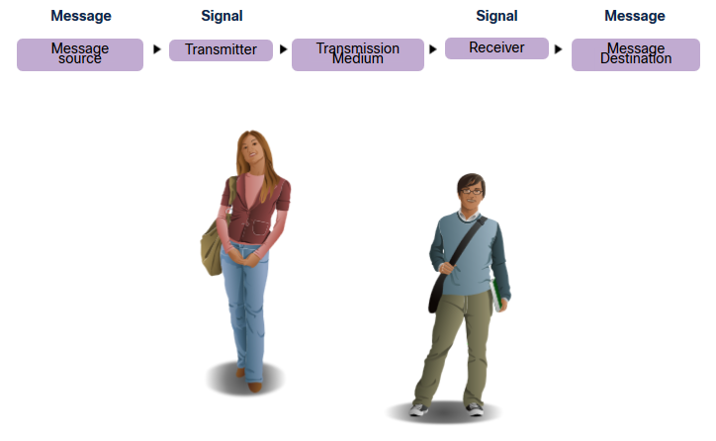
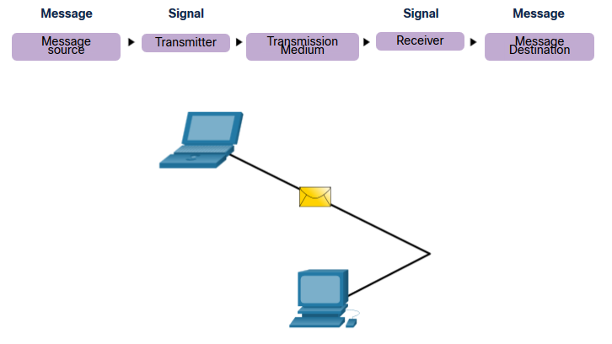
The Rules Communications Protocols
All communications are governed by protocols.
Protocols are the rules that communications will follow.
These rules will vary depending on the protocol.
Notes:
3 – Protocols and Models
3.1 – The Rules
3.1.3 – Communications Protocols

Slide 5
The Rules Rule Establishment
Protocols must account for the following requirements:
An identified sender and receiver
Common language and grammar
Speed and timing of delivery
Confirmation or acknowledgment requirements
Notes:
3 – Protocols and Models
3.1 – The Rules
3.1.4 – Rules Establishment (Cont.)

Slide 6
The Rules Network Protocol Requirements
Common computer protocols must be in agreement and include the following requirements:
Message encoding
Message formatting and encapsulation
Message size
Message timing
Message delivery options
Notes:
3 – Protocols and Models
3.1 – The Rules
3.1.5 – Network Protocol Requirements

Slide 7
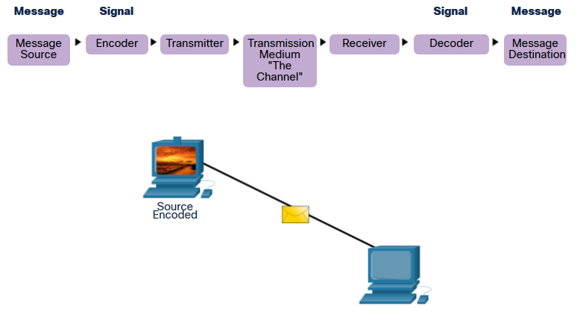
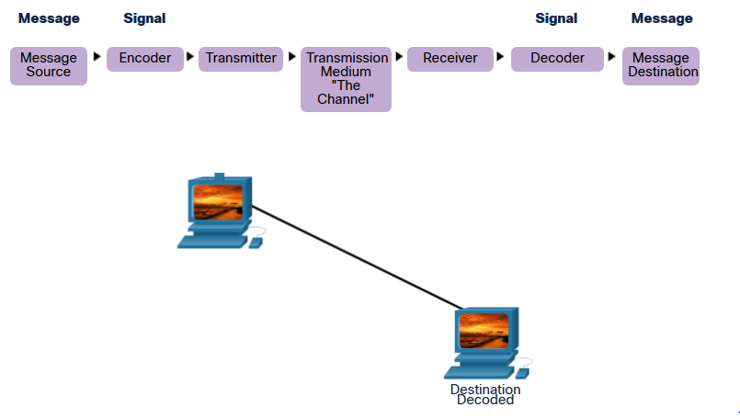
The Rules Message Encoding
Encoding is the process of converting information into another acceptable form for transmission.
Decoding reverses this process to interpret the information.
Notes:
3 – Protocols and Models
3.1 – The Rules
3.1.6 – Message Encoding

Slide 8

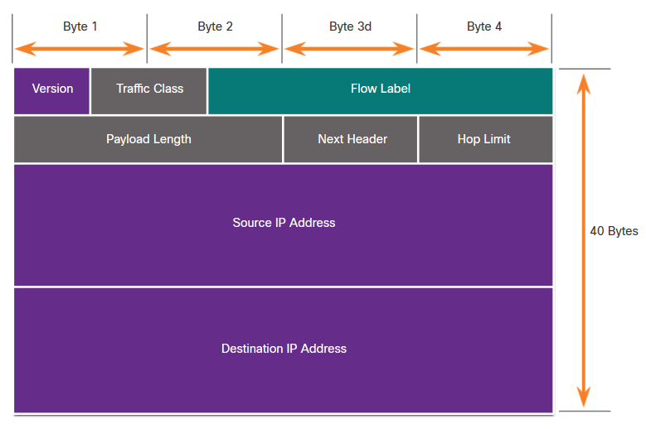
The Rules Message Formatting and Encapsulation
When a message is sent, it must use a specific format or structure.
Message formats depend on the type of message and the channel that is used to deliver the message.
Notes:
3 – Protocols and Models
3.1 – The Rules
3.1.7 – Message Formatting and Encapsulation

Slide 9
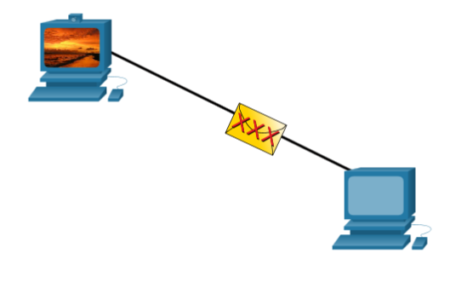
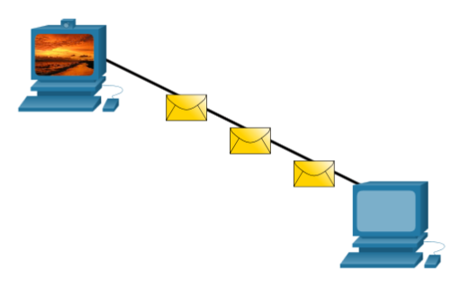
The Rules Message Size
Encoding between hosts must be in an appropriate format for the medium.
Messages sent across the network are converted to bits
The bits are encoded into a pattern of light, sound, or electrical impulses.
The destination host must decode the signals to interpret the message.
Notes:
3 – Protocols and Models
3.1 – The Rules
3.1.8 – Message Size

Slide 10
The Rules Message Timing
Message timing includes the following:
Flow Control – Manages the rate of data transmission and defines how much information can be sent and the speed at which it can be delivered.
Response Timeout – Manages how long a device waits when it does not hear a reply from the destination.
Access method - Determines when someone can send a message.
There may be various rules governing issues like “collisions”. This is when more than one device sends traffic at the same time and the messages become corrupt.
Some protocols are proactive and attempt to prevent collisions; other protocols are reactive and establish a recovery method after the collision occurs.
Notes:
3 – Protocols and Models
3.1 – The Rules
3.1.9 – Message Timing

Slide 11
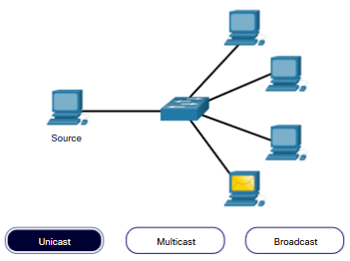
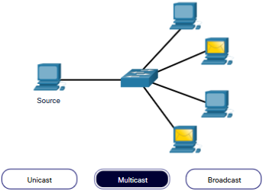
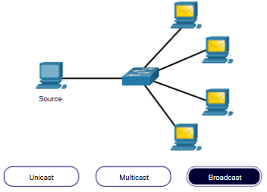
The Rules Message Delivery Options
Message delivery may one of the following methods:
Unicast – one to one communication
Multicast – one to many, typically not all
Broadcast – one to all
Note: Broadcasts are used in IPv4 networks, but are not an option for IPv6. Later we will also see “Anycast” as an additional delivery option for IPv6.
Notes:
3 – Protocols and Models
3.1 – The Rules
3.1.10 – Message Delivery Options

Slide 12
3.2 Protocols
Notes:
3 – Protocols and Models
3.2 – Protocols

Slide 13
Protocols Network Protocol Overview
Network protocols define a common set of rules.
Can be implemented on devices in:
Software
Hardware
Both
Protocols have their own:
Function
Format
Rules
Protocol Type | Description
Network Communications | enable two or more devices to communicate over one or more networks
Network Security | secure data to provide authentication, data integrity, and data encryption
Routing | enable routers to exchange route information, compare path information, and select best path
Service Discovery | used for the automatic detection of devices or services
Notes:
3 – Protocols and Models
3.2 – Protocols
3.2.1 – Network Protocol Overview

Slide 14
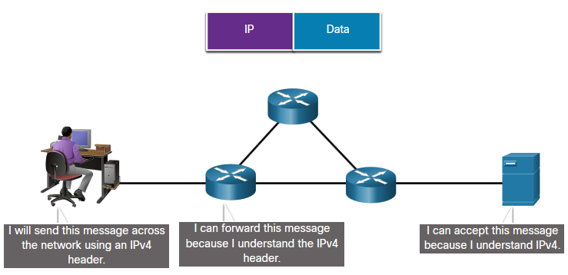
Protocols Network Protocol Functions
Devices use agreed-upon protocols to communicate.
Protocols may have one or functions.
Function | Description
Addressing | Identifies sender and receiver
Reliability | Provides guaranteed delivery
Flow Control | Ensures data flows at an efficient rate
Sequencing | Uniquely labels each transmitted segment of data
Error Detection | Determines if data became corrupted during transmission
Application Interface | Process-to-process communications between network applications
Notes:
3 – Protocols and Models
3.2 – Protocols
3.2.2 – Network Protocol Functions

Slide 15
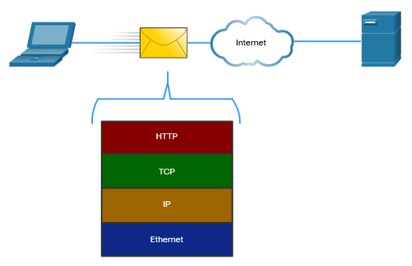
Protocols Protocol Interaction
Networks require the use of several protocols.
Each protocol has its own function and format.
Protocol | Function
Hypertext Transfer Protocol (HTTP) | Governs the way a web server and a web client interact Defines content and format
Transmission Control Protocol (TCP) | Manages the individual conversations Provides guaranteed delivery Manages flow control
Internet Protocol (IP) | Delivers messages globally from the sender to the receiver
Ethernet | Delivers messages from one NIC to another NIC on the same Ethernet Local Area Network (LAN)
Notes:
3 – Protocols and Models
3.2 – Protocols
3.2.3 – Protocol Interaction
3.2.4 – Check Your Understanding - Protocols

Slide 16
3.3 Protocol Suites
Notes:
3 – Protocols and Models
3.3 – Protocol Suites

Slide 17
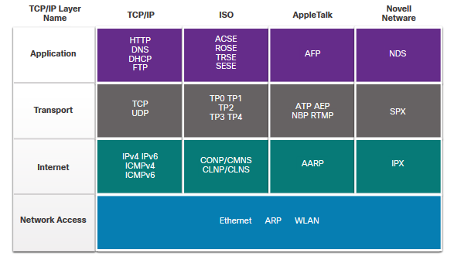
Protocol Suites Evolution of Protocol Suites
There are several protocol suites.
Internet Protocol Suite or TCP/IP- The most common protocol suite and maintained by the Internet Engineering Task Force (IETF)
Open Systems Interconnection (OSI) protocols- Developed by the International Organization for Standardization (ISO) and the International Telecommunications Union (ITU)
AppleTalk- Proprietary suite release by Apple Inc.
Novell NetWare- Proprietary suite developed by Novell Inc.
Notes:
3 – Protocols and Models
3.3 – Protocol Suites
3.3.2 – Evolution of Protocol Suites

Slide 18
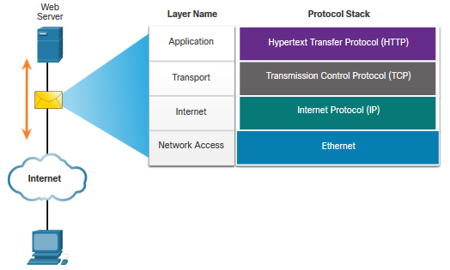
Protocol Suites TCP/IP Protocol Example
TCP/IP protocols operate at the application, transport, and internet layers.
The most common network access layer LAN protocols are Ethernet and WLAN (wireless LAN).
Notes:
3 – Protocols and Models
3.3 – Protocol Suites
3.3.3 – TCP/IP Protocol Example

Slide 19
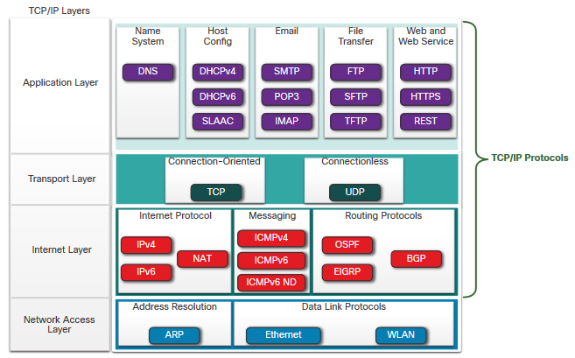
Protocol Suites TCP/IP Protocol Suite
TCP/IP is the protocol suite used by the internet and includes many protocols.
TCP/IP is:
An open standard protocol suite that is freely available to the public and can be used by any vendor
A standards-based protocol suite that is endorsed by the networking industry and approved by a standards organization to ensure interoperability
Notes:
3 – Protocols and Models
3.3 – Protocol Suites
3.3.4 – TCP/IP Protocol Suite

Slide 20
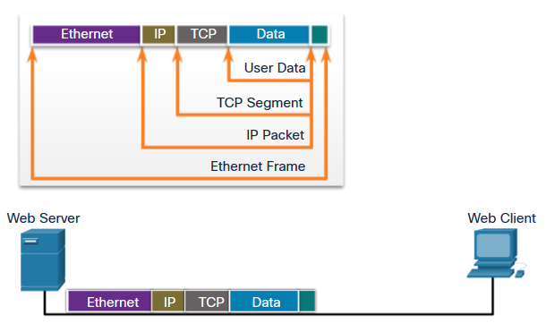
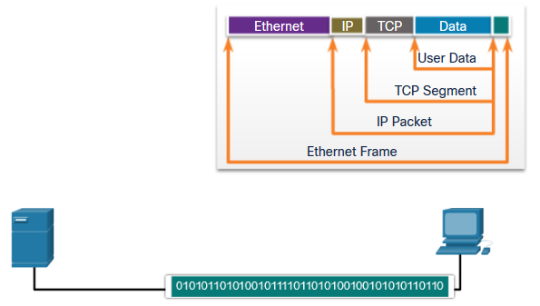
Protocol Suites TCP/IP Communication Process
A web server encapsulating and sending a web page to a client.
A client de-encapsulating the web page for the web browser
Notes:
3 – Protocols and Models
3.3 – Protocol Suites
3.3.5 – TCP/IP Communication Process
3.3.6 – Check Your Understanding – Protocol Suites

Slide 21
3.4 Standards Organizations
Notes:
3 – Protocols and Models
3.4 – Standards Organizations

Slide 22

Standards Organizations Open Standards
Open standards encourage:
interoperability
competition
innovation
Standards organizations are:
vendor-neutral
non-profit organizations
established to develop and promote the concept of open standards.
Notes:
3 – Protocols and Models
3.4 – Standards Organizations
3.4.1 – Open Standards

Slide 23
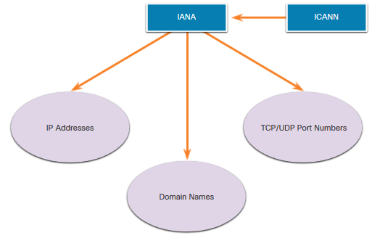
Standards Organizations Internet Standards (Cont.)
Standards organizations involved with the development and support of TCP/IP
Internet Corporation for Assigned Names and Numbers (ICANN) - Coordinates IP address allocation, the management of domain names, and assignment of other information
Internet Assigned Numbers Authority (IANA) - Oversees and manages IP address allocation, domain name management, and protocol identifiers for ICANN
Notes:
3 – Protocols and Models
3.4 – Standards Organizations
3.4.2 – Internet Standards (Cont.)

Slide 24
Standards Organizations Electronic and Communications Standards
Institute of Electrical and Electronics Engineers (IEEE, pronounced “I-triple-E”) - dedicated to creating standards in power and energy, healthcare, telecommunications, and networking
Electronic Industries Alliance (EIA) - develops standards relating to electrical wiring, connectors, and the 19-inch racks used to mount networking equipment
Telecommunications Industry Association (TIA) - develops communication standards in radio equipment, cellular towers, Voice over IP (VoIP) devices, satellite communications, and more
International Telecommunications Union-Telecommunication Standardization Sector (ITU-T) - defines standards for video compression, Internet Protocol Television (IPTV), and broadband communications, such as a digital subscriber line (DSL)
Notes:
3 – Protocols and Models
3.4 – Standards Organizations
3.4.3 – Electronic and Communications Standards

Slide 25
3.5 Reference Models
Notes:
3 – Protocols and Models
3.5 – Reference Models

Slide 26
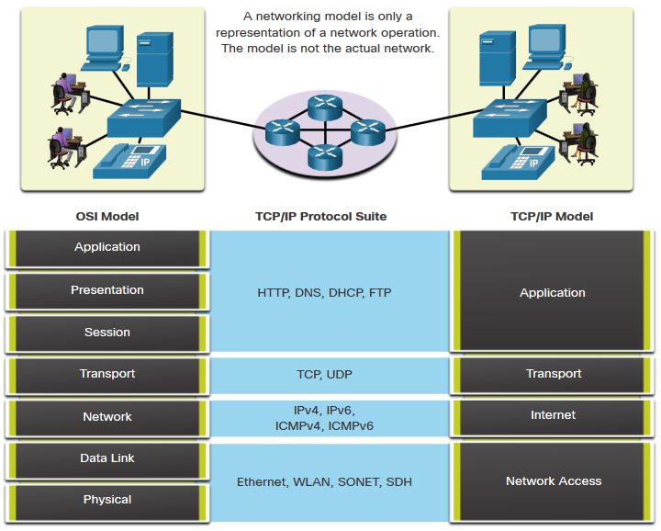
Reference Models The Benefits of Using a Layered Model
Complex concepts such as how a network operates can be difficult to explain and understand. For this reason, a layered model is used.
Two layered models describe network operations:
Open System Interconnection (OSI) Reference Model
TCP/IP Reference Model
Notes:
3 – Protocols and Models
3.5 – Reference Models
3.5.1 – The Benefits of Using a Layered Model

Slide 27
Reference Models The OSI Reference Model
OSI Model Layer | Description
7 - Application | Contains protocols used for process-to-process communications.
6 - Presentation | Provides for common representation of the data transferred between application layer services.
5 - Session | Provides services to the presentation layer and to manage data exchange.
4 - Transport | Defines services to segment, transfer, and reassemble the data for individual communications.
3 - Network | Provides services to exchange the individual packets of data over the network.
2 - Data Link | Describes methods for exchanging data frames over a common media.
1 - Physical | Describes the means to activate, maintain, and de-activate physical connections.
Notes:
3 – Protocols and Models
3.5 – Reference Models
3.5.2 – The OSI Reference Model

Slide 28
Reference Models The TCP/IP Reference Model
TCP/IP Model Layer | Description
Application | Represents data to the user, plus encoding and dialog control.
Transport | Supports communication between various devices across diverse networks.
Internet | Determines the best path through the network.
Network Access | Controls the hardware devices and media that make up the network.
Notes:
3 – Protocols and Models
3.5 – Reference Models
3.5.3 – The TCP/IP Reference Model

Slide 29
3.6 Data Encapsulation
Notes:
3 – Protocols and Models
3.6 – Data Encapsulation

Slide 30
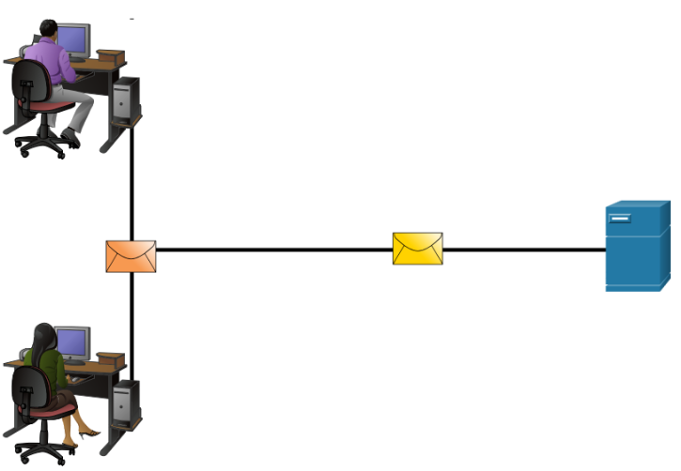
Data Encapsulation Segmenting Messages
Segmenting is the process of breaking up messages into smaller units. Multiplexing is the processes of taking multiple streams of segmented data and interleaving them together.
Segmenting messages has two primary benefits:
Increases speed - Large amounts of data can be sent over the network without tying up a communications link.
Increases efficiency - Only segments which fail to reach the destination need to be retransmitted, not the entire data stream.
Notes:
3 – Protocols and Models
3.6 – Data Encapsulation
3.6.1 – Segmenting Messages

Slide 31
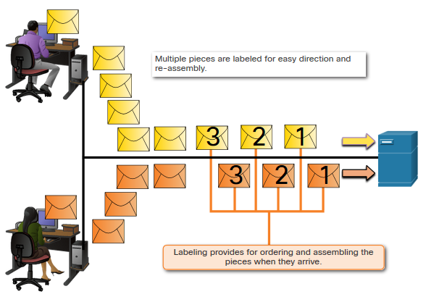
Data Encapsulation Sequencing
Sequencing messages is the process of numbering the segments so that the message may be reassembled at the destination.
TCP is responsible for sequencing the individual segments.
Notes:
3 – Protocols and Models
3.6 – Data Encapsulation
3.6.2 – Sequencing

Slide 32
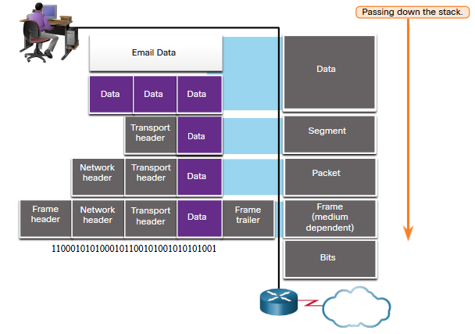
Data Encapsulation Protocol Data Units
Encapsulation is the process where protocols add their information to the data.
At each stage of the process, a PDU has a different name to reflect its new functions.
There is no universal naming convention for PDUs, in this course, the PDUs are named according to the protocols of the TCP/IP suite.
PDUs passing down the stack are as follows:
Data (Data Stream)
Segment
Packet
Frame
Bits (Bit Stream)
Notes:
3 – Protocols and Models
3.6 – Data Encapsulation
3.6.3 – Protocol Data Units

Slide 33
Data Encapsulation Encapsulation Example
Encapsulation is a top down process.
The level above does its process and then passes it down to the next level of the model. This process is repeated by each layer until it is sent out as a bit stream.
Notes:
3 – Protocols and Models
3.6 – Data Encapsulation
3.6.4 – Encapsulation Example

Slide 34
Data Encapsulation De-encapsulation Example
Data is de-encapsulated as it moves up the stack.
When a layer completes its process, that layer strips off its header and passes it up to the next level to be processed. This is repeated at each layer until it is a data stream that the application can process.
Received as Bits (Bit Stream)
Frame
Packet
Segment
Data (Data Stream)
Notes:
3 – Protocols and Models
3.6 – Data Encapsulation
3.6.5 – De-encapsulation Example
3.6.6 – Check Your Understanding – Data Encapsulation

Slide 35
3.7 Data Access
Notes:
3 – Protocols and Models
3.7 – Data Access

Slide 36
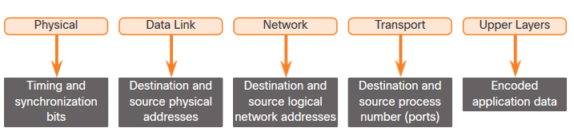
Data Access Addresses
Both the data link and network layers use addressing to deliver data from source to destination.
Network layer source and destination addresses - Responsible for delivering the IP packet from original source to the final destination.
Data link layer source and destination addresses – Responsible for delivering the data link frame from one network interface card (NIC) to another NIC on the same network.
Notes:
3 – Protocols and Models
3.7 – Data Access
3.7.1 – Addresses

Slide 37
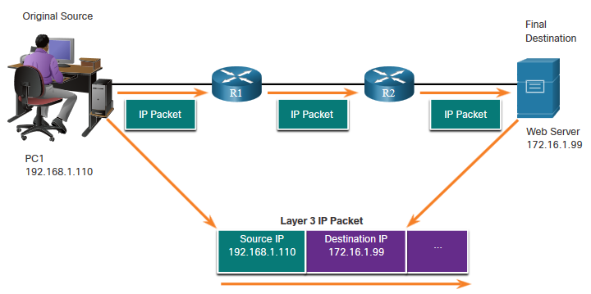
Data Access Layer 3 Logical Address
The IP packet contains two IP addresses:
Source IP address - The IP address of the sending device, original source of the packet.
Destination IP address - The IP address of the receiving device, final destination of the packet.
These addresses may be on the same link or remote.
Notes:
3 – Protocols and Models
3.7 – Data Access
3.7.2 – Layer 3 Logical Address

Slide 38
Data Access Layer 3 Logical Address (Cont.)
An IP address contains two parts:
Network portion (IPv4) or Prefix (IPv6)
The left-most part of the address indicates the network group which the IP address is a member.
Each LAN or WAN will have the same network portion.
Host portion (IPv4) or Interface ID (IPv6)
The remaining part of the address identifies a specific device within the group.
This portion is unique for each device on the network.
Notes:
3 – Protocols and Models
3.7 – Data Access
3.7.2 – Layer 3 Logical Address (Cont.)

Slide 39
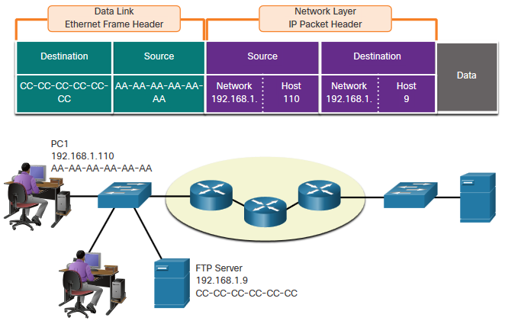
Data Access Devices on the Same Network
When devices are on the same network the source and destination will have the same number in network portion of the address.
PC1 – 192.168.1.110
FTP Server – 192.168.1.9
Notes:
3 – Protocols and Models
3.7 – Data Access
3.7.3 – Devices on the Same Network-

Slide 40
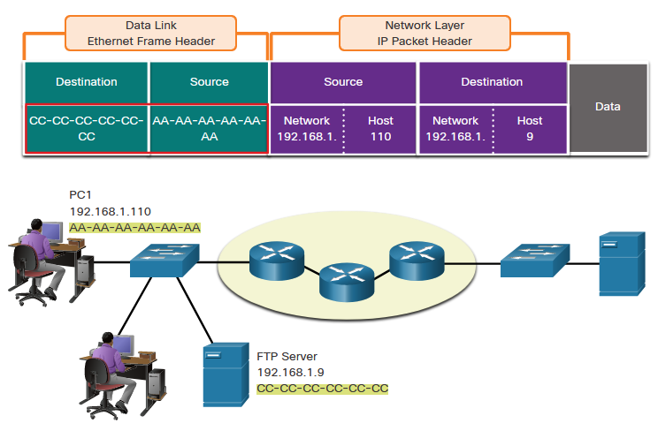
Data Access Role of the Data Link Layer Addresses: Same IP Network
When devices are on the same Ethernet network the data link frame will use the actual MAC address of the destination NIC.
MAC addresses are physically embedded into the Ethernet NIC and are local addressing.
The Source MAC address will be that of the originator on the link.
The Destination MAC address will always be on the same link as the source, even if the ultimate destination is remote.
Notes:
3 – Protocols and Models
3.7 – Data Access
3.7.4 – Role of the Data Link Layer Addresses: Same IP Network

Slide 41
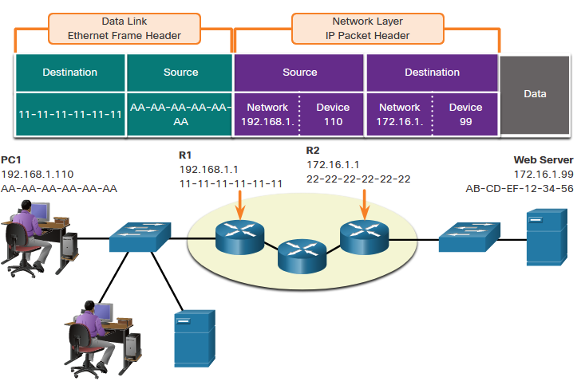
Data Access Devices on a Remote Network
What happens when the actual (ultimate) destination is not on the same LAN and is remote?
What happens when PC1 tries to reach the Web Server?
Does this impact the network and data link layers?
Notes:
3 – Protocols and Models
3.7 – Data Access
3.7.5 – Devices on a Remote Network

Slide 42
Data Access Role of the Network Layer Addresses
When the source and destination have a different network portion, this means they are on different networks.
PC1 – 192.168.1
Web Server – 172.16.1
Notes:
3 – Protocols and Models
3.7 – Data Access
3.7.6 – Role of the Network Layer Addresses

Slide 43
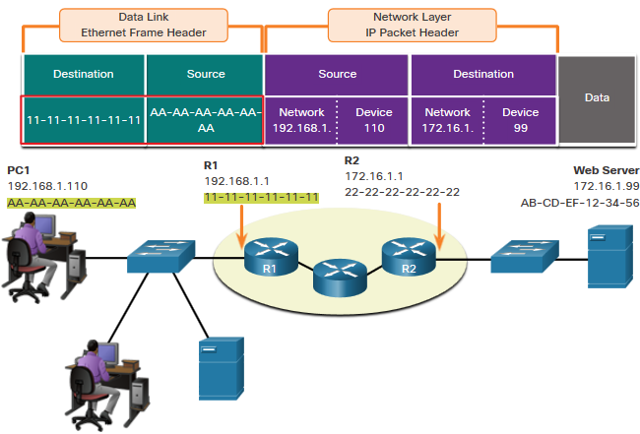
Data Access Role of the Data Link Layer Addresses: Different IP Networks
When the final destination is remote, Layer 3 will provide Layer 2 with the local default gateway IP address, also known as the router address.
The default gateway (DGW) is the router interface IP address that is part of this LAN and will be the “door” or “gateway” to all other remote locations.
All devices on the LAN must be told about this address or their traffic will be confined to the LAN only.
Once Layer 2 on PC1 forwards to the default gateway (Router), the router then can start the routing process of getting the information to actual destination.
Notes:
3 – Protocols and Models
3.7 – Data Access
3.7.7 – Role of the Data Link Layer Addresses: Different IP Networks

Slide 44
Data Access Role of the Data Link Layer Addresses: Different IP Networks (Cont.)
The data link addressing is local addressing so it will have a source and destination for each link.
The MAC addressing for the first segment is :
Source – AA-AA-AA-AA-AA-AA (PC1) Sends the frame.
Destination – 11-11-11-11-11-11 (R1- Default Gateway MAC) Receives the frame.
Note: While the L2 local addressing will change from link to link or hop to hop, the L3 addressing remains the same.
Notes:
3 – Protocols and Models
3.7 – Data Access
3.7.7 – Role of the Data Link Layer Addresses: Different IP Networks (Cont.)

Slide 45
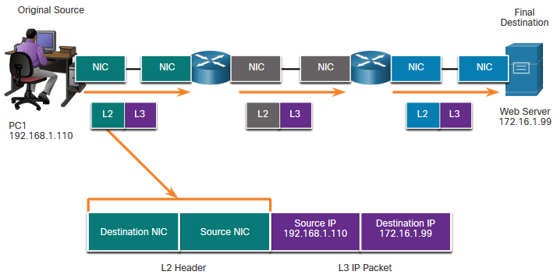
Data Access Data Link Addresses
Since data link addressing is local addressing, it will have a source and destination for each segment or hop of the journey to the destination.
The MAC addressing for the first segment is:
Source – (PC1 NIC) sends frame
Destination – (First Router- DGW interface) receives frame
Notes:
3 – Protocols and Models
3.7 – Data Access
3.7.8 – Data Link Addresses

Slide 46
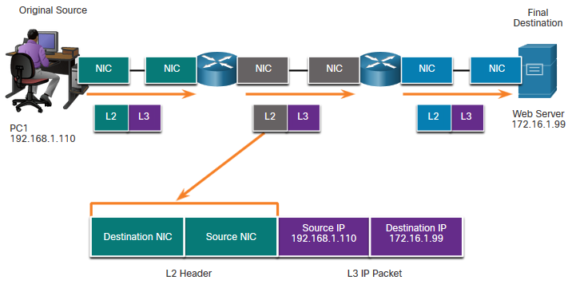
Data Access Data Link Addresses (Cont.)
The MAC addressing for the second hop is:
Source – (First Router- exit interface) sends frame
Destination – (Second Router) receives frame
Notes:
3 – Protocols and Models
3.7 – Data Access
3.7.8 – Data Link Addresses (Cont.)

Slide 47
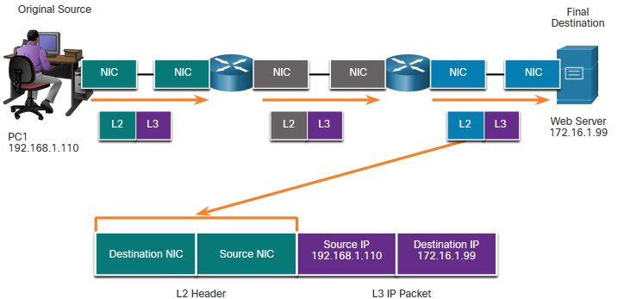
Data Access Data Link Addresses (Cont.)
The MAC addressing for the last segment is:
Source – (Second Router- exit interface) sends frame
Destination – (Web Server NIC) receives frame
Notes:
3 – Protocols and Models
3.7 – Data Access
3.7.8 – Data Link Addresses (Cont.)

Slide 48
Data Access Data Link Addresses (Cont.)
Notice that the packet is not modified, but the frame is changed, therefore the L3 IP addressing does not change from segment to segment like the L2 MAC addressing.
The L3 addressing remains the same since it is global and the ultimate destination is still the Web Server.
Notes:
3 – Protocols and Models
3.7 – Data Access
3.7.8 – Data Link Addresses (Cont.)

Slide 49
Module 4: Physical Layer
Introduction to Networks v7.0 (ITN)
Notes:
Cisco Networking Academy Program
Introduction to Networks v7.0 (ITN)
Module 4: Physical Layer

Slide 50
4.1 Purpose of the Physical Layer
Notes:
4- Physical Layer
4.1- Purpose of the Physical Layer

Slide 51
Purpose of the Physical Layer The Physical Connection
Before any network communications can occur, a physical connection to a local network must be established.
This connection could be wired or wireless, depending on the setup of the network.
This generally applies whether you are considering a corporate office or a home.
A Network Interface Card (NIC) connects a device to the network.
Some devices may have just one NIC, while others may have multiple NICs (Wired and/or Wireless, for example).
Not all physical connections offer the same level of performance.
Notes:
4 – Physical Layer
4.1 – Purpose of the Physical Layer
4.1.1 – The Physical Connection

Slide 52
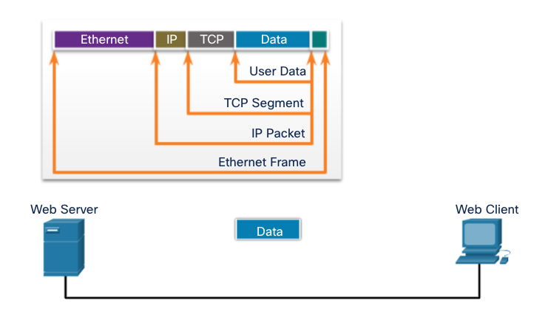
Purpose of the Physical Layer The Physical Layer
Transports bits across the network media
Accepts a complete frame from the Data Link Layer and encodes it as a series of signals that are transmitted to the local media
This is the last step in the encapsulation process.
The next device in the path to the destination receives the bits and re-encapsulates the frame, then decides what to do with it.
Notes:
4 – Physical Layer
4.1 – Purpose of the Physical Layer
4.1.2 – The Physical Layer
4.1.3 – Check Your Understanding – Purpose of the Physical Layer

Slide 53
4.2 Physical Layer Characteristics
Notes:
4 - Physical Layer
4.2 - Physical Layer Characteristics

Slide 54
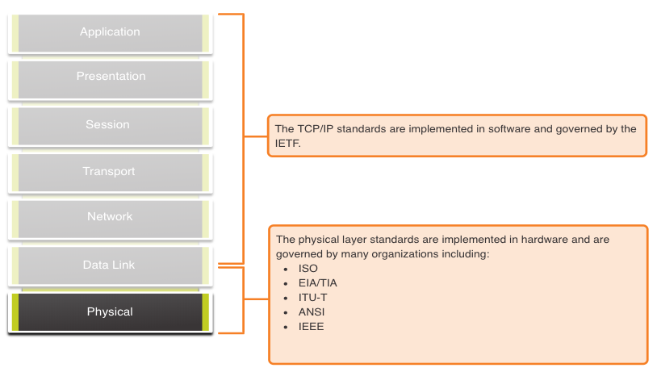
Physical Layer Characteristics Physical Layer Standards
Notes:
4 – Physical Layer
4.2 – Physical Layer Characteristics
4.2.1 – Physical Layer Standards

Slide 55
Physical Layer Characteristics Physical Components
Physical Layer Standards address three functional areas:
Physical Components
Encoding
Signaling
The Physical Components are the hardware devices, media, and other connectors that transmit the signals that represent the bits.
Hardware components like NICs, interfaces and connectors, cable materials, and cable designs are all specified in standards associated with the physical layer.
Signaling is the method by which you define what a one or zero is.
Encoding is how you use the 1s and 0s to represent information.
Notes:
4 – Physical Layer
4.2 – Physical Layer Characteristics
4.2.2 – Physical Components

Slide 56
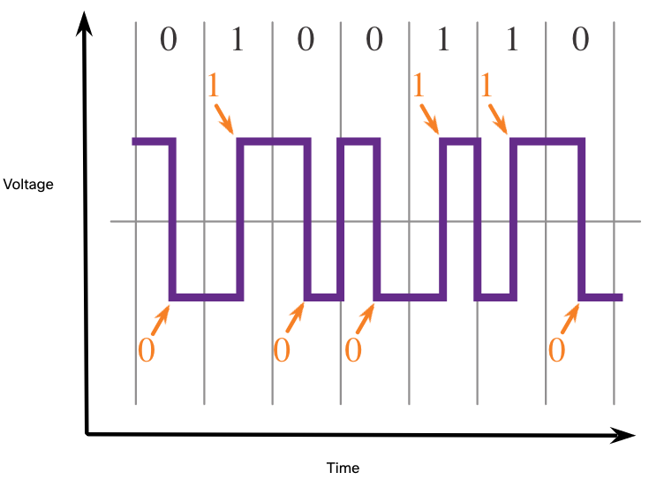
Physical Layer Characteristics Encoding
Encoding converts the stream of bits into a format recognizable by the next device in the network path.
This ‘coding’ provides predictable patterns that can be recognized by the next device.
Examples of encoding methods include Manchester (shown in the figure), 4B/5B, and 8B/10B.
The foremost significance of encoding a signal/message is to reduce the transmission cost involved.
Notes:
4 – Physical Layer
4.2 – Physical Layer Characteristics
4.2.3 – Encoding

Slide 57
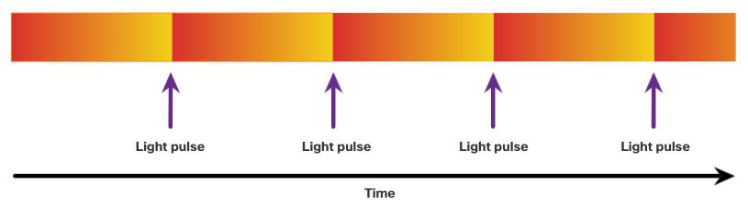
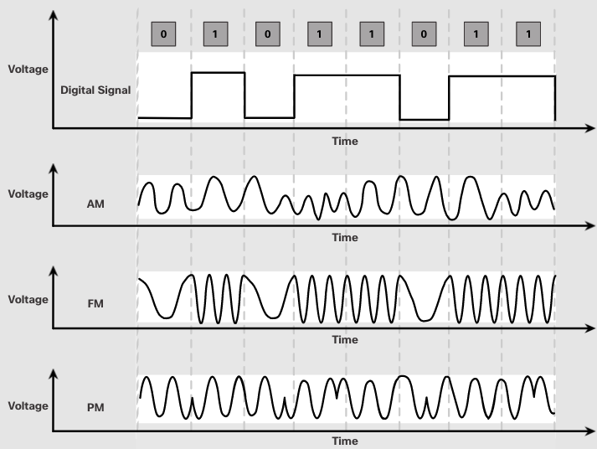
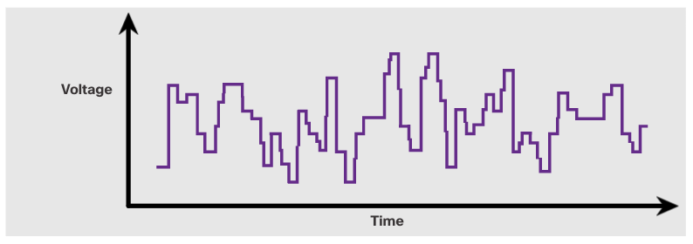
Physical Layer Characteristics Signaling
The signaling method is how the bit values, “1” and “0” are represented on the physical medium.
The method of signaling will vary based on the type of medium being used.
Light Pulses Over Fiber-Optic Cable
Electrical Signals Over Copper Cable
Microwave Signals Over Wireless
Notes:
4 – Physical Layer
4.2 – Physical Layer Characteristics
4.2.4 – Signaling

Slide 58
Physical Layer Characteristics Bandwidth
Bandwidth is the capacity at which a medium can carry data.
Digital bandwidth measures the amount of data that can flow from one place to another in a given amount of time; how many bits can be transmitted in a second.
Physical media properties, current technologies, and the laws of physics play a role in determining available bandwidth.
Unit of Bandwidth | Abbreviation | Equivalence
Bits per second | bps | 1 bps = fundamental unit of bandwidth
Kilobits per second | Kbps | 1 Kbps = 1,000 bps = 10³ bps
Megabits per second | Mbps | 1 Mbps = 1,000,000 bps = 10⁶ bps
Gigabits per second | Gbps | 1 Gbps – 1,000,000,000 bps = 10⁹ bps
Terabits per second | Tbps | 1 Tbps = 1,000,000,000,000 bps = 10¹² bps
Notes:
4 – Physical Layer
4.2 – Physical Layer Characteristics
4.2.5 – Bandwidth

Slide 59
IEC 60027-2 (2000-11) Ed. 2.0
Pri použití binárnych prefixov je iná konverzia bit rate (výrazy kibi-, mibi-, atď. nie sú preklepy):
Pre väčšie bit rate sa používajú prefixy SI sústavy, nie binárne prefixy:
1 024 bit/s | = | 1 kibit/s (jeden kibibit za sekundu)
1 048 576 bit/s | = | 1 Mibit/s (jeden mibibit za sekundu)
1 073 741 824 bit/s | = | 1 Gibit/s (jeden gibibit za sekundu)
1 000 bit/s | = | 1 kbit/s (jeden kilobit alebo tisíc bitov za sekundu)
1 000 000 bit/s | = | 1 Mbit/s (jeden megabit alebo milión bitov za sekundu)
1 000 000 000 bit/s | = | 1 Gbit/s (jeden gigabit alebo miliarda bitov za sekundu)
Zdroj:https://sk.wikipedia.org/wiki/Bin%C3%A1rny_prefix

Slide 60
Physical Layer Characteristics Bandwidth Terminology
Latency
Amount of time, including delays, for data to travel from one given point to another
Throughput
The measure of the transfer of bits across the media over a given period of time
Goodput
The measure of usable data transferred over a given period of time
Goodput = Throughput - traffic overhead
Notes:
4 – Physical Layer
4.2 – Physical Layer Characteristics
4.2.6 – Bandwidth Terminology
4.2.7 Check Your Understanding – Physical Layer Characteristics

Slide 61
4.3 Copper Cabling
Notes:
4 - Physical Layer
4.3 - Copper Cabling

Slide 62
Copper Cabling Characteristics of Copper Cabling
Copper cabling is the most common type of cabling used in networks today. It is inexpensive, easy to install, and has low resistance to electrical current flow.
Limitations:
Attenuation – the longer the electrical signals have to travel, the weaker they get.
The electrical signal is susceptible to interference from two sources, which can distort and corrupt the data signals (Electromagnetic Interference (EMI) and Radio Frequency Interference (RFI) and Crosstalk).
Mitigation:
Strict adherence to cable length limits will mitigate attenuation.
Some kinds of copper cable mitigate EMI and RFI by using metallic shielding and grounding.
Some kinds of copper cable mitigate crosstalk by twisting opposing circuit pair wires together.
Notes:
4 – Physical Layer
4.3 – Copper Cabling
4.3.1 – Characteristics of Copper Cabling

Slide 63
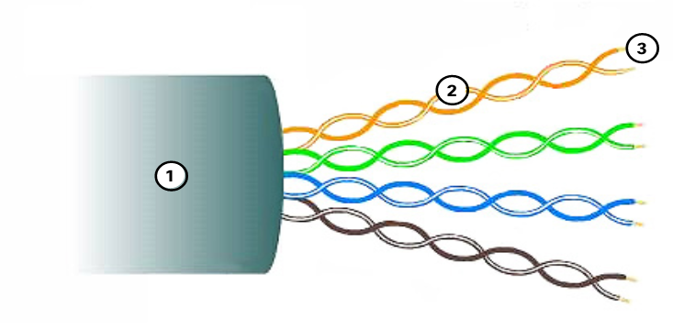
Copper Cabling Unshielded Twisted Pair (UTP)
UTP is the most common networking media.
Terminated with RJ-45 connectors
Interconnects hosts with intermediary network devices.
Key Characteristics of UTP
The outer jacket protects the copper wires from physical damage.
Twisted pairs protect the signal from interference.
Color-coded plastic insulation electrically isolates the wires from each other and identifies each pair.
Notes:
4 – Physical Layer
4.3 – Copper Cabling
4.3.3 – Unshielded Twisted Pair (UTP)

Slide 64
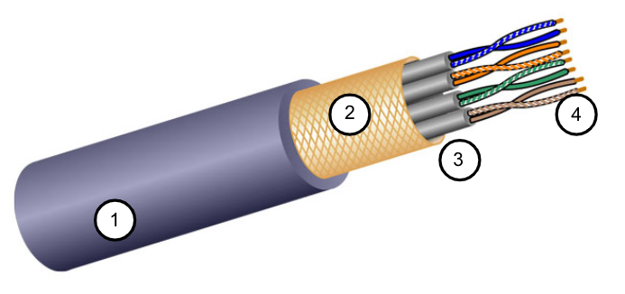
Copper Cabling Shielded Twisted Pair (STP)
Better noise protection than UTP
More expensive than UTP
Harder to install than UTP
Terminated with RJ-45 connectors
Interconnects hosts with intermediary network devices
Key Characteristics of STP
The outer jacket protects the copper wires from physical damage
Braided or foil shield provides EMI/RFI protection
Foil shield for each pair of wires provides EMI/RFI protection
Color-coded plastic insulation electrically isolates the wires from each other and identifies each pair
CAT 5, 5e, 6, 6a, 7, 7a, (8 pre dátové centrá)
Notes:
4 – Physical Layer
4.3 – Copper Cabling
4.3.4 – Shielded Twisted Pair (STP)

Slide 65
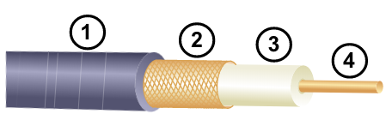
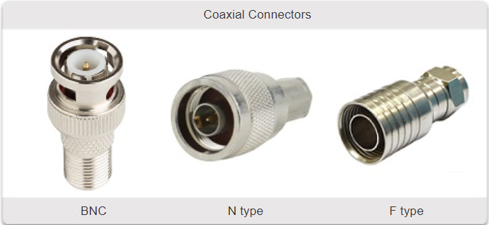
Copper Cabling Coaxial Cable
Consists of the following:
Outer cable jacket to prevent minor physical damage
A woven copper braid, or metallic foil, acts as the second wire in the circuit and as a shield for the inner conductor.
A layer of flexible plastic insulation
A copper conductor is used to transmit the electronic signals.
There are different types of connectors used with coax cable.
Commonly used in the following situations:
Wireless installations - attach antennas to wireless devices
Cable internet installations - customer premises wiring
Notes:
4 – Physical Layer
4.3 – Copper Cabling
4.3.5 – Coaxial Cable
4.3.6 Check Your Understanding – Copper Cabling

Slide 66
4.4 UTP Cabling
Notes:
4 -Physical Layer
4.4 - UTP cabling

Slide 67
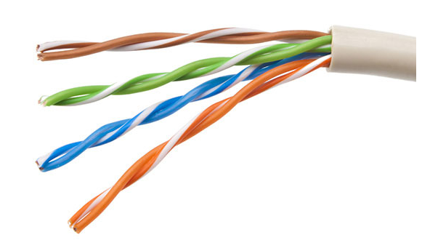
UTP Cabling Properties of UTP Cabling
UTP has four pairs of color-coded copper wires twisted together and encased in a flexible plastic sheath. No shielding is used. UTP relies on the following properties to limit crosstalk:
Cancellation - Each wire in a pair of wires uses opposite polarity. One wire is negative, the other wire is positive. They are twisted together and the magnetic fields effectively cancel each other and outside EMI/RFI.
Variation in twists per foot in each wire - Each wire is twisted a different amount, which helps prevent crosstalk amongst the wires in the cable.
Notes:
4 – Physical Layer
4.4 – UTP Cabling
4.4.1 – Properties of UTP Cabling

Slide 68
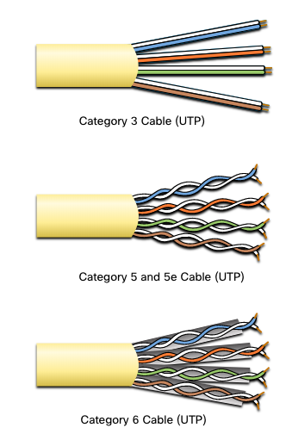
UTP Cabling UTP Cabling Standards and Connectors
Standards for UTP are established by the TIA/EIA. TIA/EIA-568 standardizes elements like:
Cable Types
Cable Lengths
Connectors
Cable Termination
Testing Methods
Electrical standards for copper cabling are established by the IEEE, which rates cable according to its performance. Examples include:
Category 3
Category 5 and 5e
Category 6
Notes:
4 – Physical Layer
4.4 – UTP Cabling
4.4.2 - UTP Cabling Standards and Connectors

Slide 69
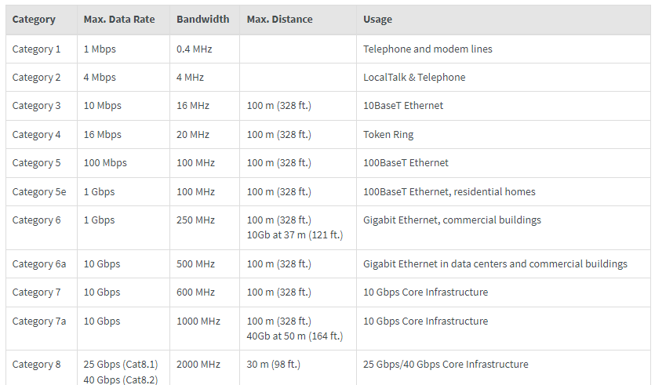
Ethernet cable categories
Notes:
Ethernet Cables Explained | Tripp Lite

Slide 70
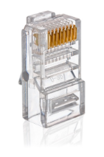
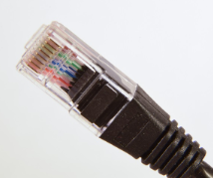
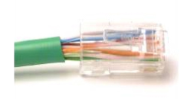
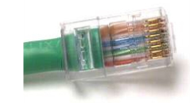
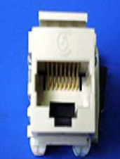
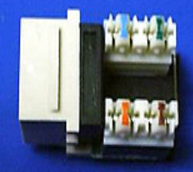
UTP Cabling UTP Cabling Standards and Connectors (Cont.)
RJ-45 Connector
Poorly terminated UTP cable
Properly terminated UTP cable
RJ-45 Socket
Notes:
4 – Physical Layer
4.4 – UTP Cabling
4.4.2 – UTP Cabling Standards and Connectors

Slide 71

UTP Cabling Straight-through and Crossover UTP Cables
Cable Type | Standard | Application
Ethernet Straight-through | Both ends T568A or T568B | Host to Network Device
Ethernet Crossover * | One end T568A, other end T568B | Host-to-Host, Switch-to-Switch, Router-to-Router
* Considered Legacy due to most NICs using Auto-MDIX to sense cable type and complete connection
Rollover | Cisco Proprietary | Host serial port to Router or Switch Console Port, using an adapter
Notes:
4 – Physical Layer
4.4 – UTP Cabling
4.4.3 – Straight-through and Crossover UTP Cables
4.4.4 – Activity – Cable Pinouts

Slide 72
4.5 Fiber-Optic Cabling
Notes:
4- Physical Layer
4.5 - Fiber-Optic Cabling

Slide 73
Fiber-Optic Cabling Properties of Fiber-Optic Cabling
Not as common as UTP because of the expense involved
Ideal for some networking scenarios
Transmits data over longer distances at higher bandwidth than any other networking media
Less susceptible to attenuation, and completely immune to EMI/RFI
Made of flexible, extremely thin strands of very pure glass
Uses a laser or LED to encode bits as pulses of light
The fiber-optic cable acts as a wave guide to transmit light between the two ends with minimal signal loss
Notes:
4 – Physical Layer
4.5 – Fiber-Optic Cabling
4.5.1 – Properties of Fiber-Optic Cabling

Slide 74


Fiber-Optic Cabling Types of Fiber Media
Single-Mode Fiber
Multimode Fiber
Very small core
Uses expensive lasers
Long-distance applications
Larger core
Uses less expensive LEDs
LEDs transmit at different angles
Up to 10 Gbps over 550 meters
Dispersion refers to the spreading out of a light pulse over time. Increased dispersion means increased loss of signal strength. MMF has greater dispersion than SMF, with a the maximum cable distance for MMF is 550 meters.
Notes:
4 – Physical Layer
4.5 – Fiber-Optic Cabling
4.5.2 – Types of Fiber Media

Slide 75
Fiber-Optic Cabling Fiber-Optic Cabling Usage
Fiber-optic cabling is now being used in four types of industry:
Enterprise Networks - Used for backbone cabling applications and interconnecting infrastructure devices
Fiber-to-the-Home (FTTH) - Used to provide always-on broadband services to homes and small businesses
Long-Haul Networks - Used by service providers to connect countries and cities
Submarine Cable Networks - Used to provide reliable high-speed, high-capacity solutions capable of surviving in harsh undersea environments at up to transoceanic distances.
Our focus in this course is the use of fiber within the enterprise.
Notes:
4 – Physical Layer
4.5 – Fiber-Optic Cabling
4.5.3 – Fiber-Optic Cabling Usage

Slide 76




Fiber-Optic Cabling Fiber-Optic Connectors
Straight-Tip (ST) Connectors
Lucent Connector (LC) Simplex Connectors
Subscriber Connector (SC) Connectors
Duplex Multimode LC Connectors
Notes:
4 – Physical Layer
4.5 – Fiber-Optic Cabling
4.5.4 – Fiber-Optic Connectors

Slide 77




Fiber-Optic Cabling Fiber Patch Cords
SC-SC MM Patch Cord
LC-LC SM Patch Cord
ST-LC MM Patch Cord
ST-SC SM Patch Cord
A yellow jacket is for single-mode fiber cables and orange (or aqua) for multimode fiber cables.
Notes:
4 – Physical Layer
4.5 – Fiber-Optic Cabling
4.5.5 - Fiber Patch Cords

Slide 78
Fiber-Optic Cabling Fiber versus Copper
Optical fiber is primarily used as backbone cabling for high-traffic, point-to-point
connections between data distribution facilities and for the interconnection of buildings
in multi-building campuses.
Implementation Issues | UTP Cabling | Fiber-Optic Cabling
Bandwidth supported | 10 Mb/s - 10 Gb/s | 10 Mb/s - 100 Gb/s
Distance | Relatively short (1 - 100 meters) | Relatively long ( 1 - 100,000 meters)
Immunity to EMI and RFI | Low | High (Completely immune)
Immunity to electrical hazards | Low | High (Completely immune)
Media and connector costs | Lowest | Highest
Installation skills required | Lowest | Highest
Safety precautions | Lowest | Highest
Notes:
4 – Physical Layer
4.5 – Fiber-Optic Cabling
4.5.6 – Fiber versus Copper
4.5.7 – Check Your Understanding – Fiber-Optic Cabling

Slide 79
4.6 Wireless Media
Notes:
4 - Physical Layer
4.6 - Wireless Media

Slide 80
Wireless Media Properties of Wireless Media
It carries electromagnetic signals representing binary digits using radio or microwave frequencies. This provides the greatest mobility option. Wireless connection numbers continue to increase.
Some of the limitations of wireless:
Coverage area - Effective coverage can be significantly impacted by the physical characteristics of the deployment location.
Interference - Wireless is susceptible to interference and can be disrupted by many common devices.
Security - Wireless communication coverage requires no access to a physical strand of media, so anyone can gain access to the transmission.
Shared medium - WLANs operate in half-duplex, which means only one device can send or receive at a time. Many users accessing the WLAN simultaneously results in reduced bandwidth for each user.
Notes:
4 – Physical Layer
4.6 – Wireless Media
4.6.1 – Properties of Wireless Media

Slide 81
Wireless Media Types of Wireless Media
The IEEE and telecommunications industry standards for wireless data communications
cover both the data link and physical layers. In each of these standards, physical layer
specifications dictate:
Data to radio signal encoding methods
Frequency and power of transmission
Signal reception and decoding requirements
Antenna design and construction
Wireless Standards:
Wi-Fi (IEEE 802.11) - Wireless LAN (WLAN) technology
Bluetooth (IEEE 802.15) - Wireless Personal Area network (WPAN) standard
WiMAX (IEEE 802.16) - Uses a point-to-multipoint topology to provide broadband wireless access
Zigbee (IEEE 802.15.4) - Low data-rate, low power-consumption communications, primarily for Internet of Things (IoT) applications
Notes:
4 – Physical Layer
4.6 – Wireless Media
4.6.2 - Types of Wireless Media

Slide 82
IEEE 802.11 standards
Standard | Frequency Bands | Maximum Speed | Introduction Year
IEEE 802.11 | 2.4 GHz | 2 Mbps | 1997
IEEE 802.11a | 5 GHz | 54 Mbps | 1999
IEEE 802.11b | 2.4 GHz | 11 Mbps | 1999
IEEE 802.11g | 2.4 GHz | 54 Mbps | 2003
IEEE 802.11n (Wi-Fi 4) | 2.4 GHz, 5 GHz | 600 Mbps | 2009
IEEE 802.11ac (Wi-Fi 5) | 5 GHz | 1+ Gbps | 2013
IEEE 802.11ax (Wi-Fi 6) | 2.4 GHz, 5 GHz, 6 GHz | 10 Gbps | 2019
IEEE 802.11be (Wi-Fi 7) | 6 GHz | 30 Gbps | 2024
EEE 802.11bn (Wi-Fi 8) |  |  | Vo vývoji

Slide 83
Wireless Media Wireless LAN
In general, a Wireless LAN (WLAN) requires the following devices:
Wireless Access Point (AP) - Concentrate wireless signals from users and connect to the existing copper-based network infrastructure
Wireless NIC Adapters - Provide wireless communications capability to network hosts
There are a number of WLAN standards. When purchasing WLAN equipment, ensure compatibility, and interoperability.
Network Administrators must develop and apply stringent security policies and processes to protect WLANs from unauthorized access and damage.
Notes:
4 – Physical Layer
4.6 – Wireless Media
4.6.3 – Wireless LAN
4.6.4 – Check Your Understanding – Wireless Media

